Slide 1
Factory Automation and Control Methods
Lecture 9: Material Transport Systems
Daro VAN
Paragon International University
Faculty of Engineering
Department of Industrial Engineering

Slide 2
Outline
Overview of Material Handing
Material handling equipment
Design considerations in material handling
Material Transport Equipment
Industrial trucks
Automated guided vehicle
Rail-guided vehicles
Conveyors, cranes and hoists
Analysis of Material Transport Systems
Analysis of vehicle-based systems
Conveyor analysis

Slide 3
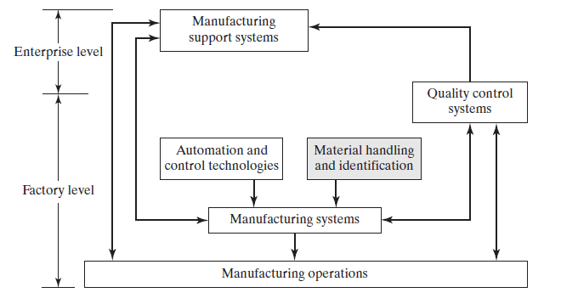
Overview of Material Handing

Slide 4
Overview of Material Handing
“the movement, protection, storage and control of materials and products throughout the process of manufacture and distribution, consumption and disposal”
The handling of materials must be performed
safely,
efficiently,
at low cost,
in a timely manner,
accurately (the right materials in the right quantities to the right locations), and
without damage to the materials.

Slide 5
Overview of Material Handing
acquisition
storage
Logistic
Movement
distribution
Planning and control

Slide 6
Overview of Material Handing
Logistics operations can be divided into two basic categories:
External logistics is concerned with transportation and related activities that occur outside of a facility.
Internal logistics, more popularly known as material handling, involves the movement and storage of materials inside a given facility

Slide 7
Overview of Material Handing
Material Handling Equipment
The equipment can be classified into five categories :
transport equipment,
positioning equipment,
unit load formation equipment,
storage equipment,
Identification and control equipment.

Slide 8
Overview of Material Handing
Material Handling Equipment
Transport Equipment is used to move material inside the factory, warehouse or other facility.
Five main types of equipment are
industrial trucks,
automated guided vehicles,
rail-guided vehicles,
conveyors,
hoists and cranes.

Slide 9
Overview of Material Handing
Material Handling Equipment
Position Equipment is used to handle parts and other materials at a single location.
Loading and unloading part from a production machine in the cell.
Positioning is accomplished by industrial robots that perform material handling
Part feeders in automated assembly
Etc …

Slide 10
Overview of Material Handing
Material Handling Equipment
Unit Load Formation Equipment refers to
containers used to hold individual items during handling
Ex. tote pans, boxes, baskets, barrels and more.
equipment used to load and package the containers.

Slide 11
Overview of Material Handing
Material Handling Equipment
Storage Equipment
Storage methods and equipment can be classified into two major categories:
conventional storage methods
bulk storage (storing items in an open floor area),
rack systems (for pallets),
shelving and bins, and
drawer storage.
automated storage systems.

Slide 12
Overview of Material Handing
Material Handling Equipment
Identification and Control Equipment : keep track of the materials being moved and stored.
This is usually done by affixing some kind of label to the item, carton, or unit load that uniquely identifies it.

Slide 13
Overview of Material Handing
Design Consideration in Material Handling
The system must be specified and configured to satisfy the requirements of a particular application.
Design of the system depends on
the materials to be handled,
quantities and
distances to be moved,
type of production facility served by the handling system, and
other factors, including available budget.

Slide 14
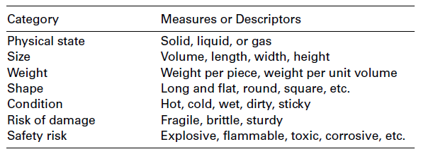
Overview of Material Handing
Design Consideration in Material Handling
Physical characteristics

Slide 15
Overview of Material Handing
Design Consideration in Material Handling
Flow Rate, Routing, and Scheduling
The amount of material moved per unit time is referred to as the flow rate.
Depending on the form of the material, flow rate is measured in pieces per hour, pallet loads per hour, tons per hour, or similar units.
Whether the material must be moved as individual units, in batches, or continuously has an effect on the selection of handling method.

Slide 16
Overview of Material Handing
Design Consideration in Material Handling
Flow Rate, Routing, and Scheduling
Routing factors include pickup and drop-off locations, move distances, routing variations, and conditions that exist along the routes.
Given that other factors remain constant, handling cost is directly related to the distance of the move: The longer the move distance, the greater the cost

Slide 17
Overview of Material Handing
Design Consideration in Material Handling
Flow Rate, Routing, and Scheduling
Scheduling relates to the timing of each individual delivery.
The material must be picked up and delivered promptly to its proper destination to maintain peak performance and efficiency of the overall system.
Scheduling urgency is often mitigated by providing space for buffer stocks of materials at pickup and drop-off points.

Slide 18
Overview of Material Handing
Design Consideration in Material Handling
Plant Layout
The material handling system is an important factor in plant layout design. When a new facility is being planned, the handling system should be considered part of the layout.
In this way, there is greater opportunity to create a layout that optimizes material flow in the building and utilizes the most appropriate type of handling system.

Slide 19
Material Transport Equipment
Material transport equipment commonly used to move parts and other materials in manufacturing and warehouse facilities:
Industrial trucks, manual and powered;
automated guided vehicles;
rail-guided vehicles;
(4) conveyors; and
(5) cranes and hoists.

Slide 20
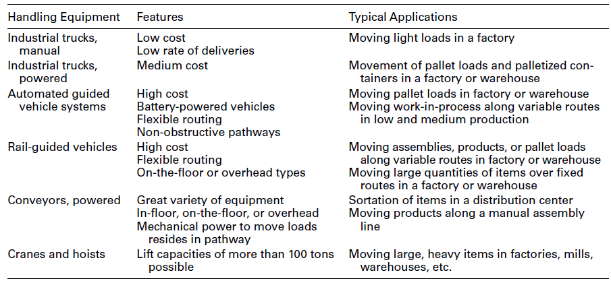
Material Transport Equipment

Slide 21
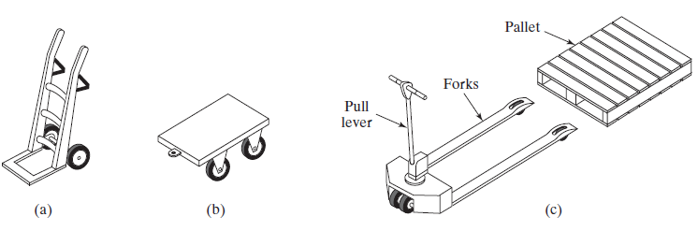
Material Transport Equipment
Industrial Trucks
nonpowered industrial trucks (hand trucks): (a) two-wheel hand truck, (b) four-wheel dolly, and (c) hand-operated low-lift pallet truck.

Slide 22
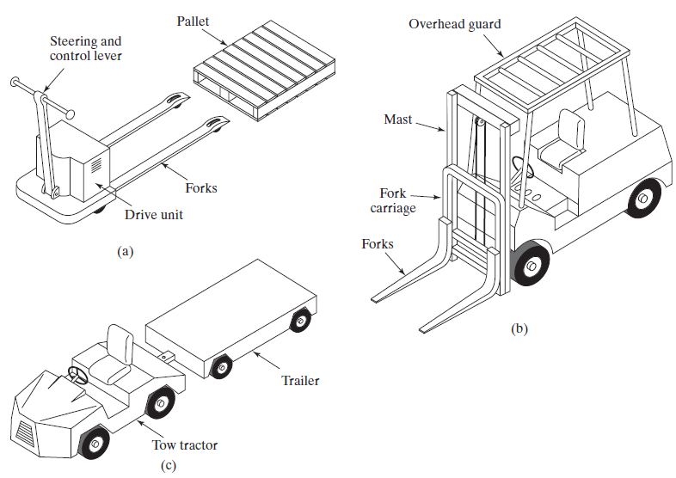
Material Transport Equipment
Industrial Trucks
Three principal types of powered trucks: (a) walkie truck, (b) forklift truck,
and (c) towing tractor

Slide 23
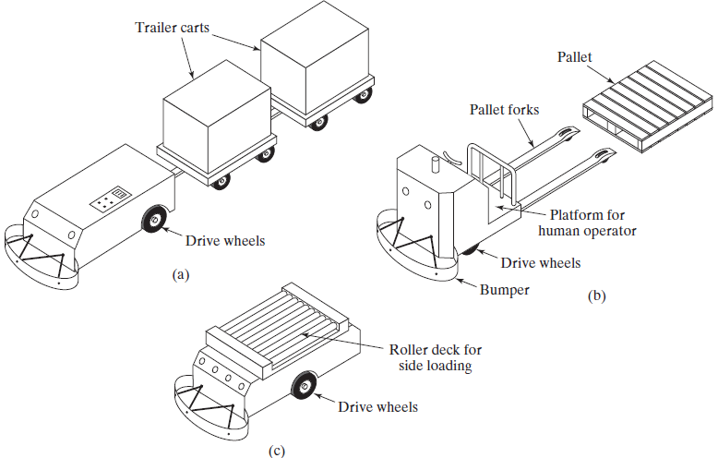
Material Transport Equipment
Automated Guided Vehicles
Three types of automated guided vehicles: (a) driverless automated guided train, (b) AGV pallet truck, and (c) unit load carrier.

Slide 24
Material Transport Equipment
Rail-Guided Vehicles
The rail system consists of either one rail, called a monorail, or two parallel rails.

Slide 25
Material Transport Equipment
Conveyors
A conveyor is a mechanical apparatus for moving items or bulk materials, usually inside a facility.
Conveyors are generally used when material must be moved in relatively large quantities between specific locations over a fixed path, which may be in the floor, above the floor, or overhead. Conveyors are either powered or nonpowered.

Slide 26
Material Transport Equipment
Conveyors
In powered conveyors, the power mechanism is contained in the fixed path, using chains, belts, rotating rolls, or other devices to propel loads along the path. Powered conveyors are commonly
used in automated material transport systems in manufacturing plants, warehouses, and distribution centers.
In nonpowered conveyors, materials are moved either manually by
human workers who push the loads along the fixed path or by gravity from one elevation
to a lower elevation.

Slide 27
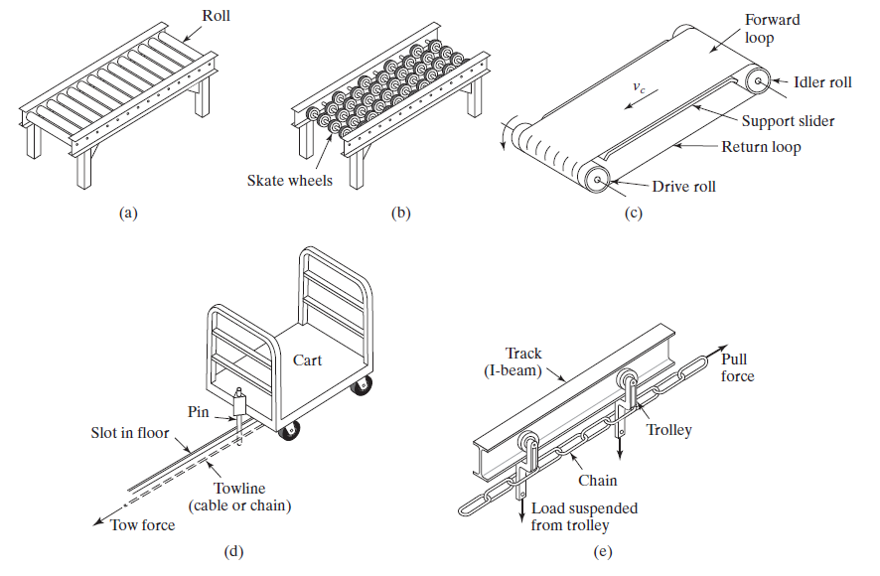
Material Transport Equipment
Types of Conveyors: (a) Roller conveyor, (b) skate-wheel conveyor, (c) belt (flat) conveyor
(support frame not shown), (d) in-floor towline conveyor, and (e) overhead trolley conveyor.

Slide 28
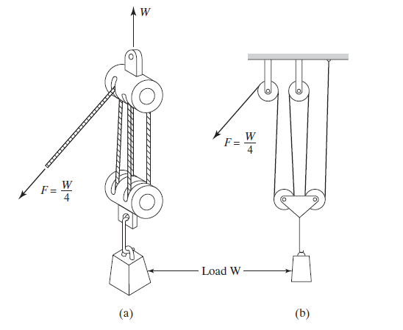
Material Transport Equipment
Cranes and Hoists
A hoist with a mechanical advantage of 4.0: (a) sketch
of the hoist and (b) diagram to illustrate mechanical advantage

Slide 29
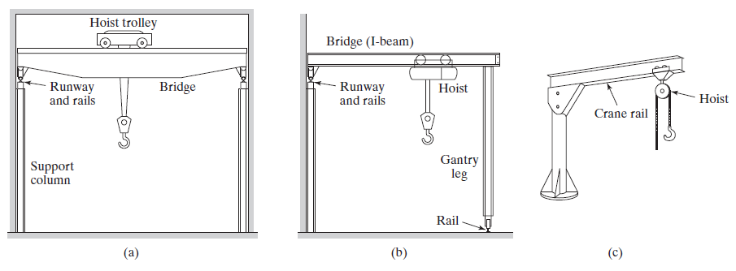
Material Transport Equipment
Cranes and Hoists
Three types of cranes: (a) bridge crane, (b) gantry crane (a half gantry
crane is shown), and (c) jib crane

Slide 30
Analysis of Material Transport Systems
Quantitative models are useful for analyzing material flow rates, delivery cycle times, and other aspects of system performance.
The analysis may be useful in determining equipment requirements
how many forklift trucks will be required to satisfy a specified flow rate.
Material transport systems can be classified as vehicle-based systems or conveyor systems
…etc

Slide 31
Analysis of Material Transport Systems
Quantitative models are useful for analyzing material flow rates, delivery cycle times, and other aspects of system performance.
The analysis may be useful in determining equipment requirements
how many forklift trucks will be required to satisfy a specified flow rate.
Material transport systems can be classified as vehicle-based systems or conveyor systems
…etc

Slide 32
Analysis of Material Transport Systems
Analysis of Vehicle-Based Systems
Two graphical tools that are useful for displaying and analyzing data in these deliveries are the
The from-to chart is a table that can be used to indicate material flow data and/or distances between multiple locations.
Network diagrams can also be used to indicate the same type of information. A network diagram consists of nodes and arrows, and the arrows indicate relationships among the nodes. In material handling, the nodes represent locations (e.g., load and unload stations), and the arrows represent material flows and/or distances between the stations.

Slide 33
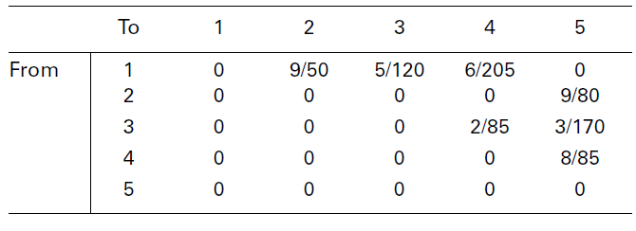
Analysis of Material Transport Systems
Analysis of Vehicle-Based Systems
From-To Chart Showing Flow Rates, loads/hr (Value Before the Slash), and Travel Distances, m (Value After the Slash), Between Stations in a Layout

Slide 34
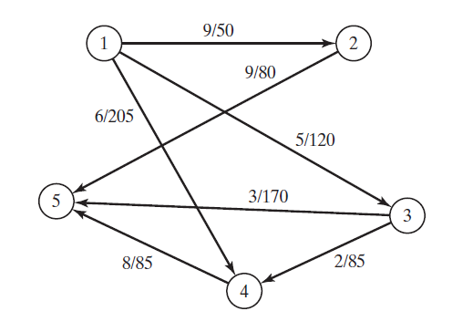
Analysis of Material Transport Systems
Analysis of Vehicle-Based Systems
Network diagram showing material deliveries between load/unload stations.
Nodes represent the load/unload stations, and arrows are labeled with flow rates,
loads/hr, and distances m.

Slide 35
Analysis of Material Transport Systems
Analysis of Vehicle-Based Systems
The time for a typical delivery cycle in the operation of a vehicle-based transport system consists of
loading at the pickup station,
Travel time to the drop-off station,
unloading at the drop-off station, and
empty travel time of the vehicle between deliveries.

Slide 36
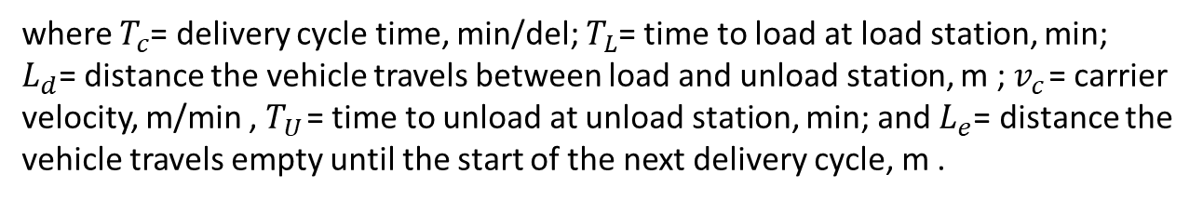
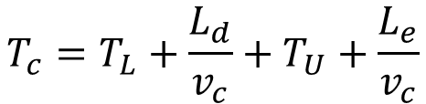
Analysis of Material Transport Systems
Analysis of Vehicle-Based Systems
The total cycle time per delivery per vehicle is given by
$$T_{c}=T_{L}+\frac{L_{d}}{v_{c}}+T_{U}+\frac{L_{e}}{v_{c}}$$
where $T_{c}$= delivery cycle time, min/del; $T_{L}$= time to load at load station, min;
$L_{d}$= distance the vehicle travels between load and unload station, m ; $v_{c}$ = carrier velocity, m/min , $T_{U}$ = time to unload at unload station, min; and $L_{e}$= distance the vehicle travels empty until the start of the next delivery cycle, m .

Slide 37
Analysis of Material Transport Systems
Analysis of Vehicle-Based Systems
The delivery cycle time Tc can be used to determine two values of interest in a vehicle-based transport system:
rate of deliveries per vehicle
number of vehicles required to satisfy a specified total delivery requirement.
The analysis is based on hourly rates and requirements, but the equations can readily be adapted for other time periods.

Slide 38
Analysis of Material Transport Systems
Analysis of Vehicle-Based Systems
The hourly rate of deliveries per vehicle is 60 min divided by the delivery cycle time Tc, adjusting for any time losses during the hour.
The possible time losses include
availability,
traffic congestion, and
efficiency of manual drivers in the case of manually
operated trucks.
Note :Availability A is a reliability factor defined as the proportion
of total shift time that the vehicle is operational and not broken down or being repaired.

Slide 39
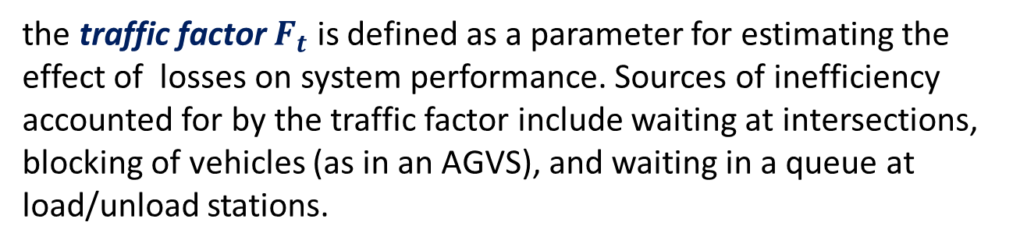
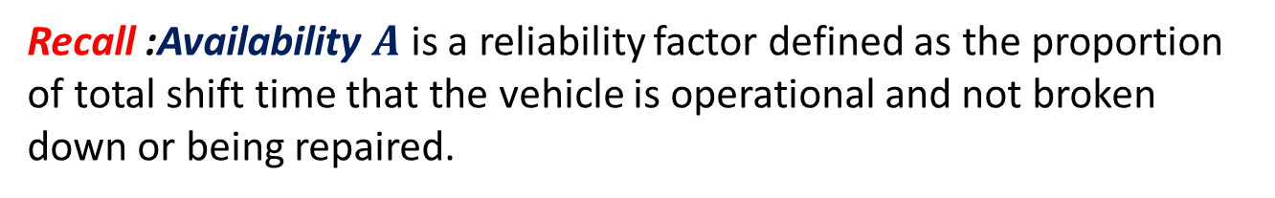
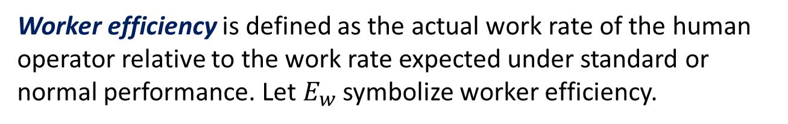
Analysis of Material Transport Systems
Analysis of Vehicle-Based Systems
Recall :Availability $A$ is a reliability factor defined as the proportion
of total shift time that the vehicle is operational and not broken down or being repaired.
the traffic factor $F_{t}$ is defined as a parameter for estimating the effect of losses on system performance. Sources of inefficiency accounted for by the traffic factor include waiting at intersections, blocking of vehicles (as in an AGVS), and waiting in a queue at load/unload stations.
Worker efficiency is defined as the actual work rate of the human operator relative to the work rate expected under standard or normal performance. Let $E_{w}$ symbolize worker efficiency.

Slide 40


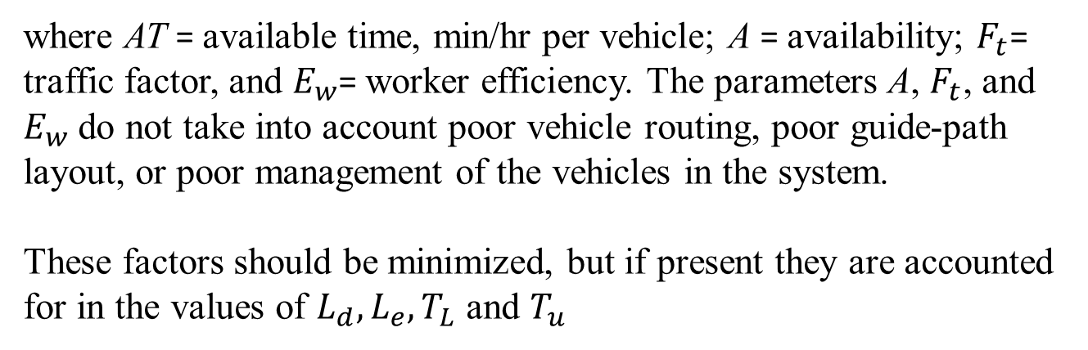
Analysis of Material Transport Systems
Analysis of Vehicle-Based Systems
With these factors defined, the available time per hour per vehicle can now be expressed as 60 min adjusted by $A,F_{t}$, and $E_{w}$. That is,
$$AT=60AF_{t}E_{w}$$
where AT = available time, min/hr per vehicle; A = availability; $F_{t}$= traffic factor, and $E_{w}$= worker efficiency. The parameters A, $F_{t}$, and $E_{w}$ do not take into account poor vehicle routing, poor guide-path layout, or poor management of the vehicles in the system.
These factors should be minimized, but if present they are accounted for in the values of $L_{d},L_{e},T_{L}$ and $T_{u}$

Slide 41
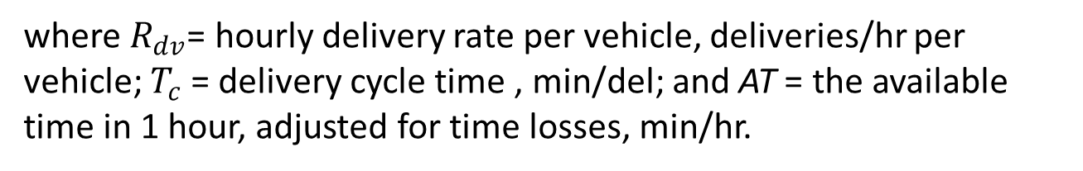
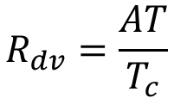
Analysis of Material Transport Systems
Analysis of Vehicle-Based Systems
The rate of deliveries per vehicle is given by
$$R_{dv}=\frac{AT}{T_{c}}$$
where $R_{dv}$= hourly delivery rate per vehicle, deliveries/hr per vehicle; $T_{c}$ = delivery cycle time , min/del; and AT = the available time in 1 hour, adjusted for time losses, min/hr.

Slide 42
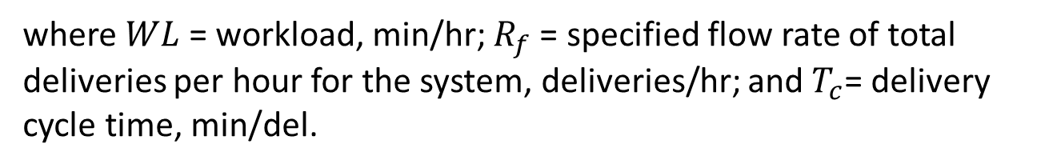

Analysis of Material Transport Systems
Analysis of Vehicle-Based Systems
Workload is defined as the total amount of work, expressed in terms of time, that must be accomplished by the material transport system in 1 hr. This can be expressed as
$$WL=R_{f}T_{c}$$
where $WL$ = workload, min/hr; $R_{f}$ = specified flow rate of total deliveries per hour for the system, deliveries/hr; and $T_{c}$= delivery cycle time, min/del.

Slide 43
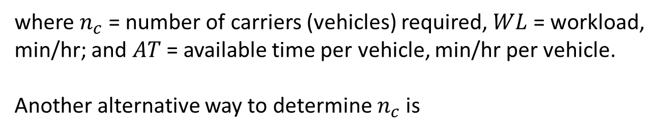
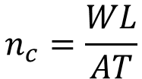
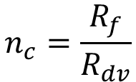
Analysis of Material Transport Systems
Analysis of Vehicle-Based Systems
The number of vehicles required to accomplish this workload can be written as
$$n_{c}=\frac{WL}{AT}$$
where $n_{c}$ = number of carriers (vehicles) required, $WL$ = workload, min/hr; and $AT$ = available time per vehicle, min/hr per vehicle.
Another alternative way to determine $n_{c}$ is
$$n_{c}=\frac{R_{f}}{R_{dv}}$$

Slide 44
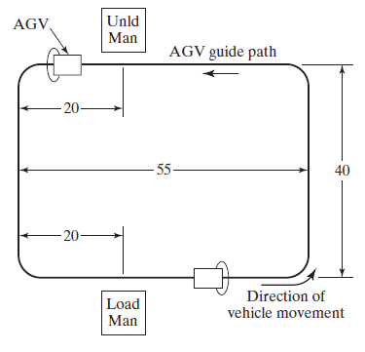
Analysis of Material Transport Systems
Analysis of Vehicle-Based Systems
Consider the AGVS layout on the left. Vehicles
travel counterclockwise around the loop to deliver
loads from the load station to the unload station.
Loading time at the load station = 0.75 min, and
unloading time at the unload station = 0.50 min.
The following performance parameters are given:
vehicle speed = 50 m/min, availability = 0.95, and
traffic factor = 0.90. Operator efficiency does not
apply, so Ew = 1.0.
Determine
(a) travel distances loaded and empty,
(b) ideal delivery cycle time, and
(c) number of vehicles required to satisfy the delivery demand if a total of 40 deliveries per hour must be completed by the AGVS.

Slide 45
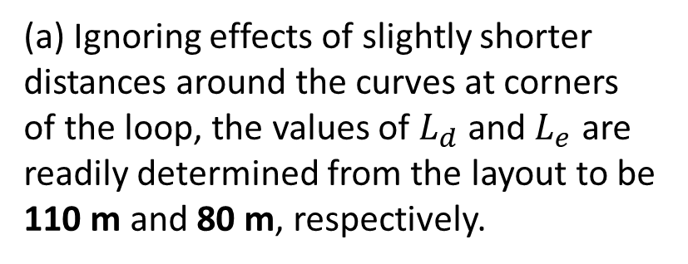
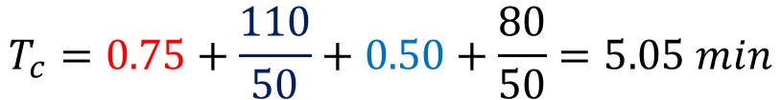
Analysis of Material Transport Systems
Analysis of Vehicle-Based Systems
(a) Ignoring effects of slightly shorter distances around the curves at corners
of the loop, the values of $L_{d}$ and $L_{e}$ are readily determined from the layout to be 110 m and 80 m, respectively.
(b) Ideal cycle time per delivery per vehicle is
$$T_{c}=0.75+\frac{110}{50}+0.50+\frac{80}{50}=5.05 min$$

Slide 46

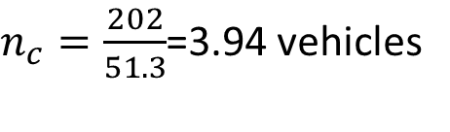
Analysis of Material Transport Systems
Analysis of Vehicle-Based Systems
(c) To determine the number of vehicles required to make 40 deliveries/hr,
compute the workload of the AGVS and the available time per hour per vehicle:
$$WL=40\left(5.05\right)=202 min/hr$$
Therefore, the number of vehicles required is
$n_{c}=\frac{202}{51.3}$=3.94 vehicles
This value should be rounded up to 4 vehicles, since the number of vehicles must be an integer.

Slide 47
References
Mikell P. Groover, “Automation, Production Systems and Computer-integrated Manufacturing” , 4th edition, Pearson, chapter 10

